Slide 1
Persistence of soil respiration legacies induced by temporally repackaged summer rainfall in Sonoran Desert grasslands
Jacob Blais¹
Mentor: Nathan Pierce^{1,2}
Co-authors: Nathan Pierce^{1,2}, Matthew Roby^{1,2,3}, Anastasia Makhnykina^{1,4,5}, Daniel Potts⁶, William Smith¹, and Joel Biederman^{1,2}
¹School of Natural Resources and the Environment, UA ²Southwest Watershed Research Center, USDA-ARS ³Sustainable Agricultural Water Systems, USDA-ARS ⁴V.N.Sukachev Institute of Forest SB RAS, Russia ⁵Siberian Federal University, Russia ⁶SUNY Buffalo State
Arizona NASA Space Grant Statewide Symposium
Tucson, AZ, April 23rd, 2022

Slide 2
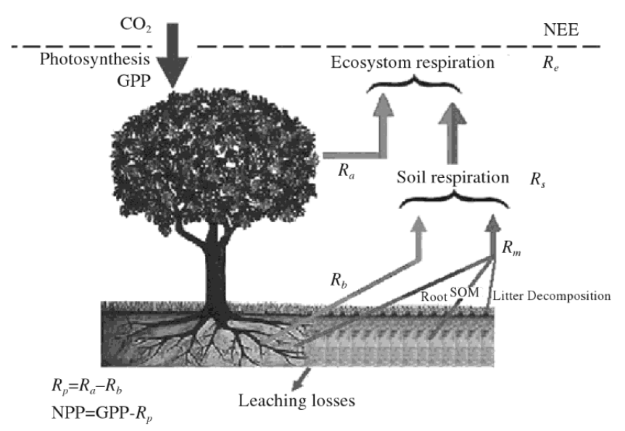
What is soil respiration?
Soil respiration (CO₂ efflux) is an important but often overlooked component of ecosystem carbon balance with the atmosphere.
Derived from plant roots and microbial decomposition.
Controlled by the microbial community, substrate availability, moisture, and temperature.
Ecosystem respiration
Source: Luo & Zhou, 2006

Slide 3
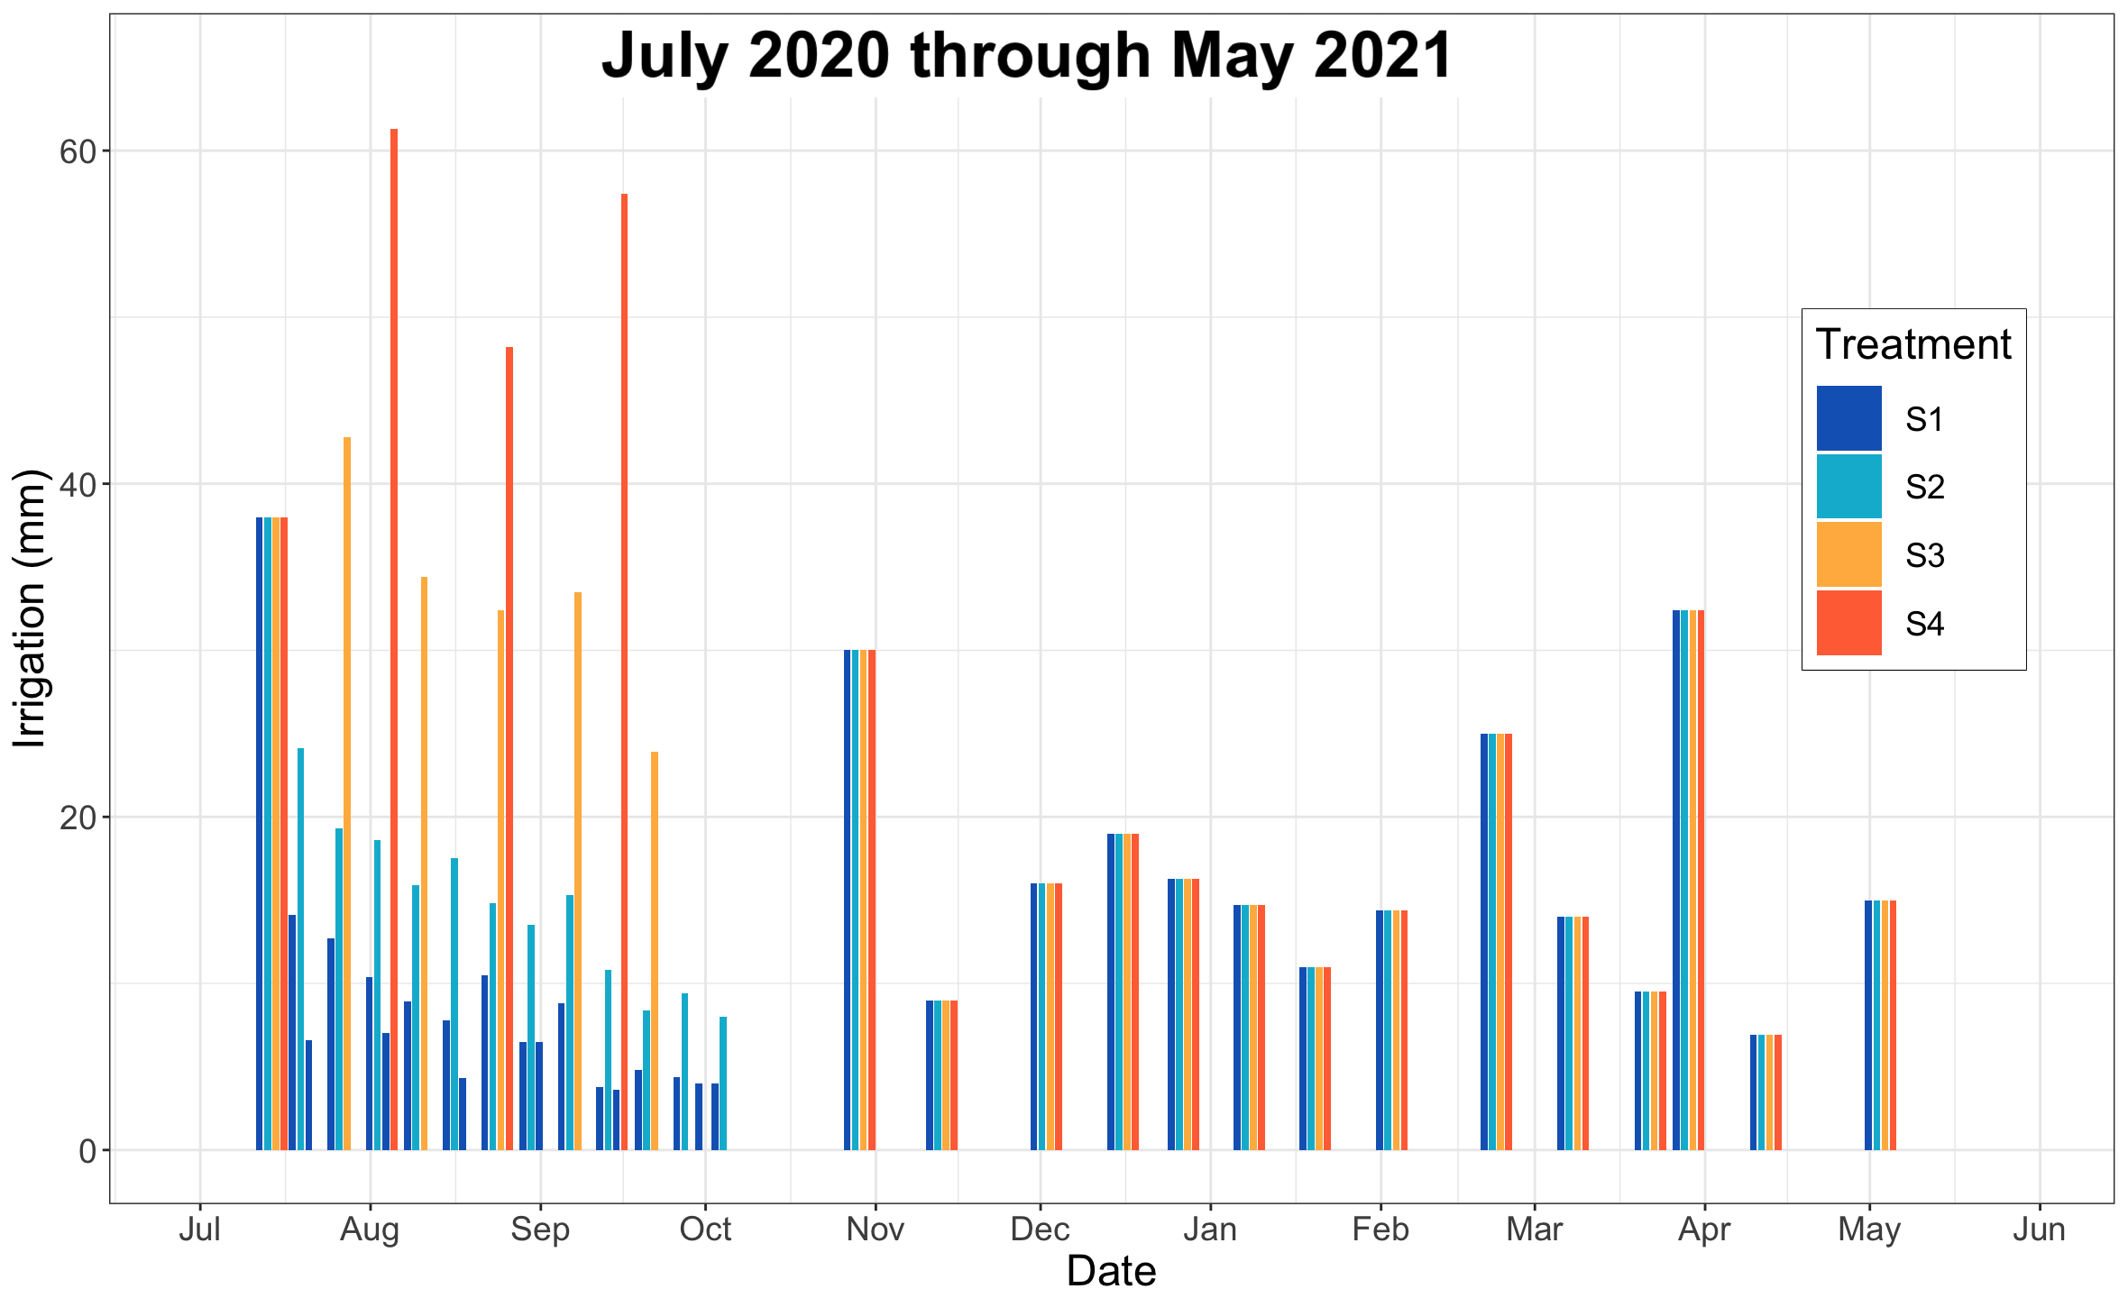
Irrigation treatments
Background
Summer monsoon growing season
In the southwestern U.S., monsoonal precipitation events are becoming less frequent yet more intense.¹
Subsequent cool season
¹Zhang et al., 2021

Slide 4
Temporal repackaging of summer precipitation
Background
Many, small events with short dry intervals
Long-term average
Few, large events with longer dry intervals
S1
S2
S3
S4

Slide 5
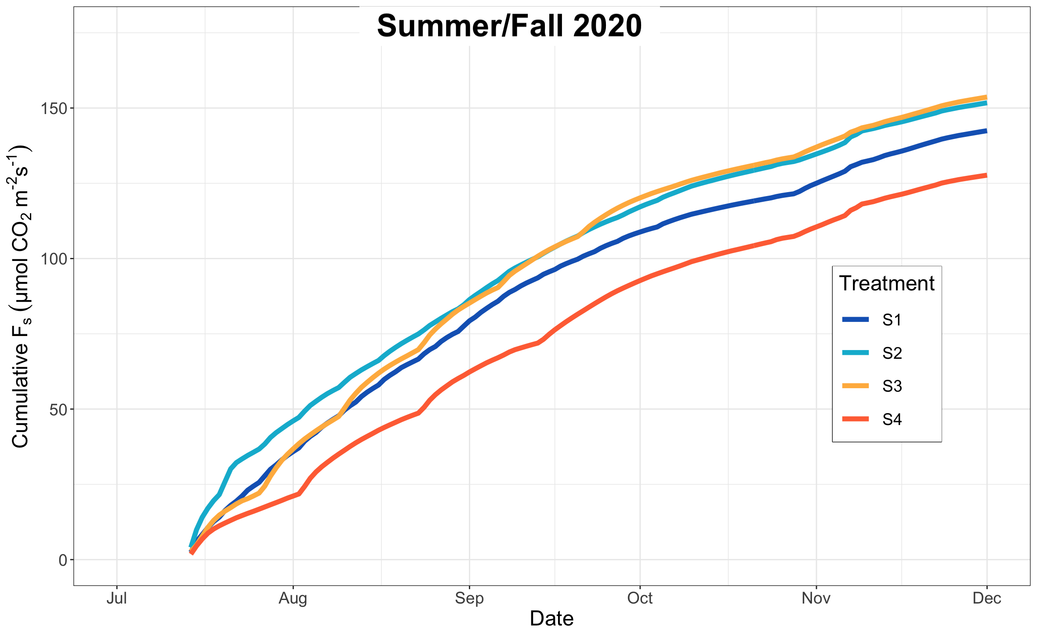
Larger and less frequent events
Background
Less available moisture in biologically active soil layers
Less total summer soil respiration
S1 = Many, small
S4 = Few, large
F_{s} = Soil CO₂ efflux
It is unknown if temporal repackaging of summer precipitation continues to influence soil respiration the following spring, i.e., a ‘legacy effect’.
5

Slide 6
Questions
Does the temporal repackaging of summer growing season precipitation alter the soil CO₂ efflux during subsequent seasons?
If so, how long does the legacy effect last and what might be driving it?

Slide 7
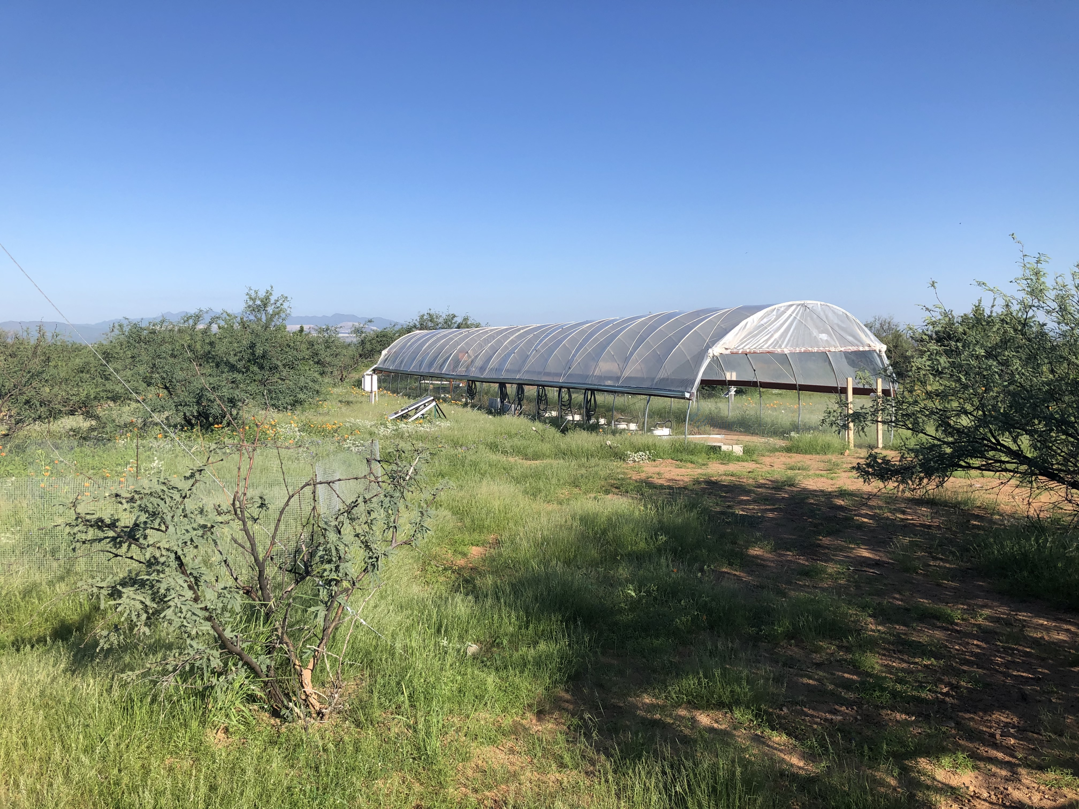
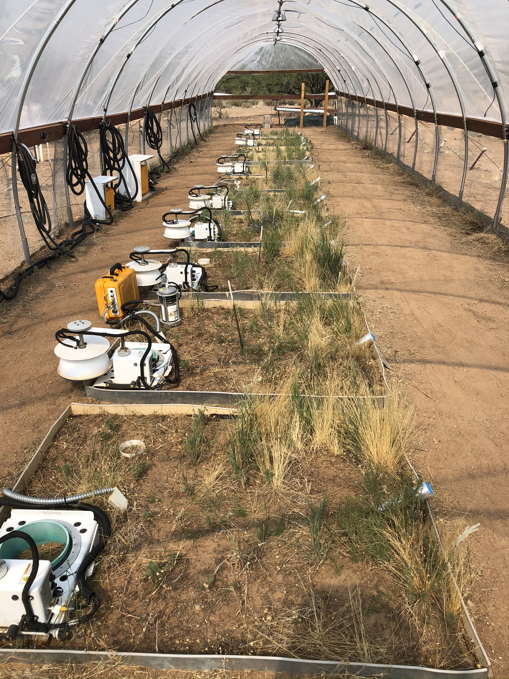
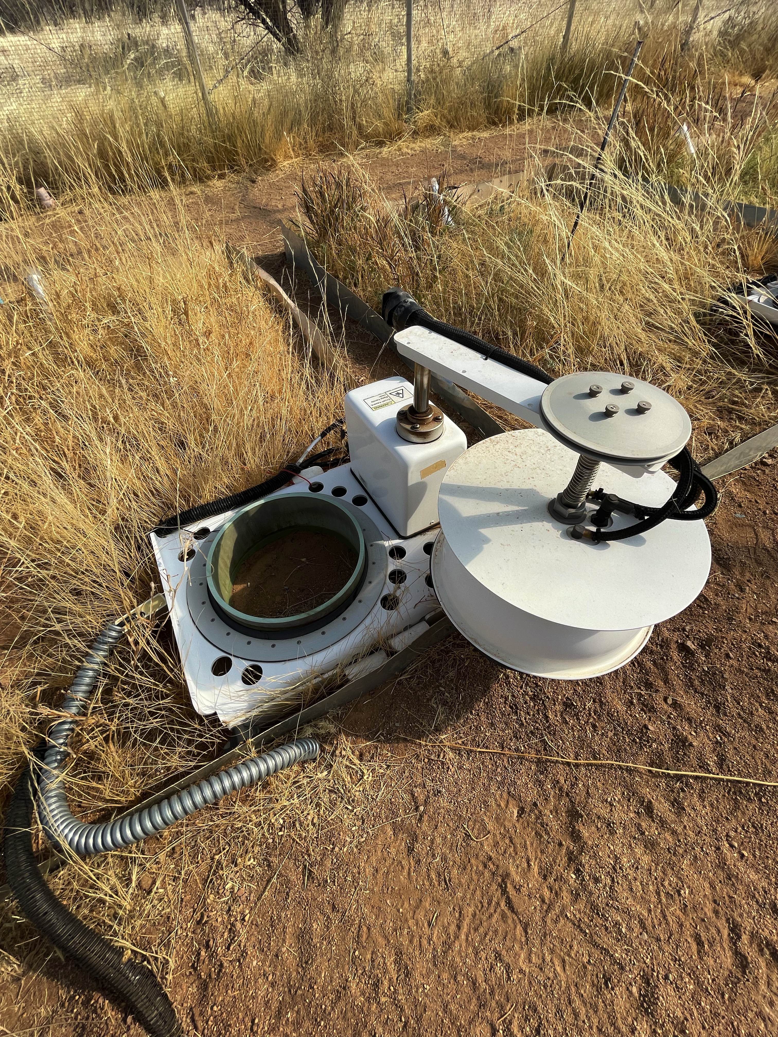
Methods
Data collected at RainManSR, a multi-year rainfall manipulation experimental site.
Automated in-situ chambers measure soil respiration hourly.
July 2020 through May 2021.
Two replicates of the four irrigation treatments (n = 2 per treatment).

Slide 8
Keeping the irrigation regime in mind…
S1 = Many, small
S4 = Few, large

Slide 9
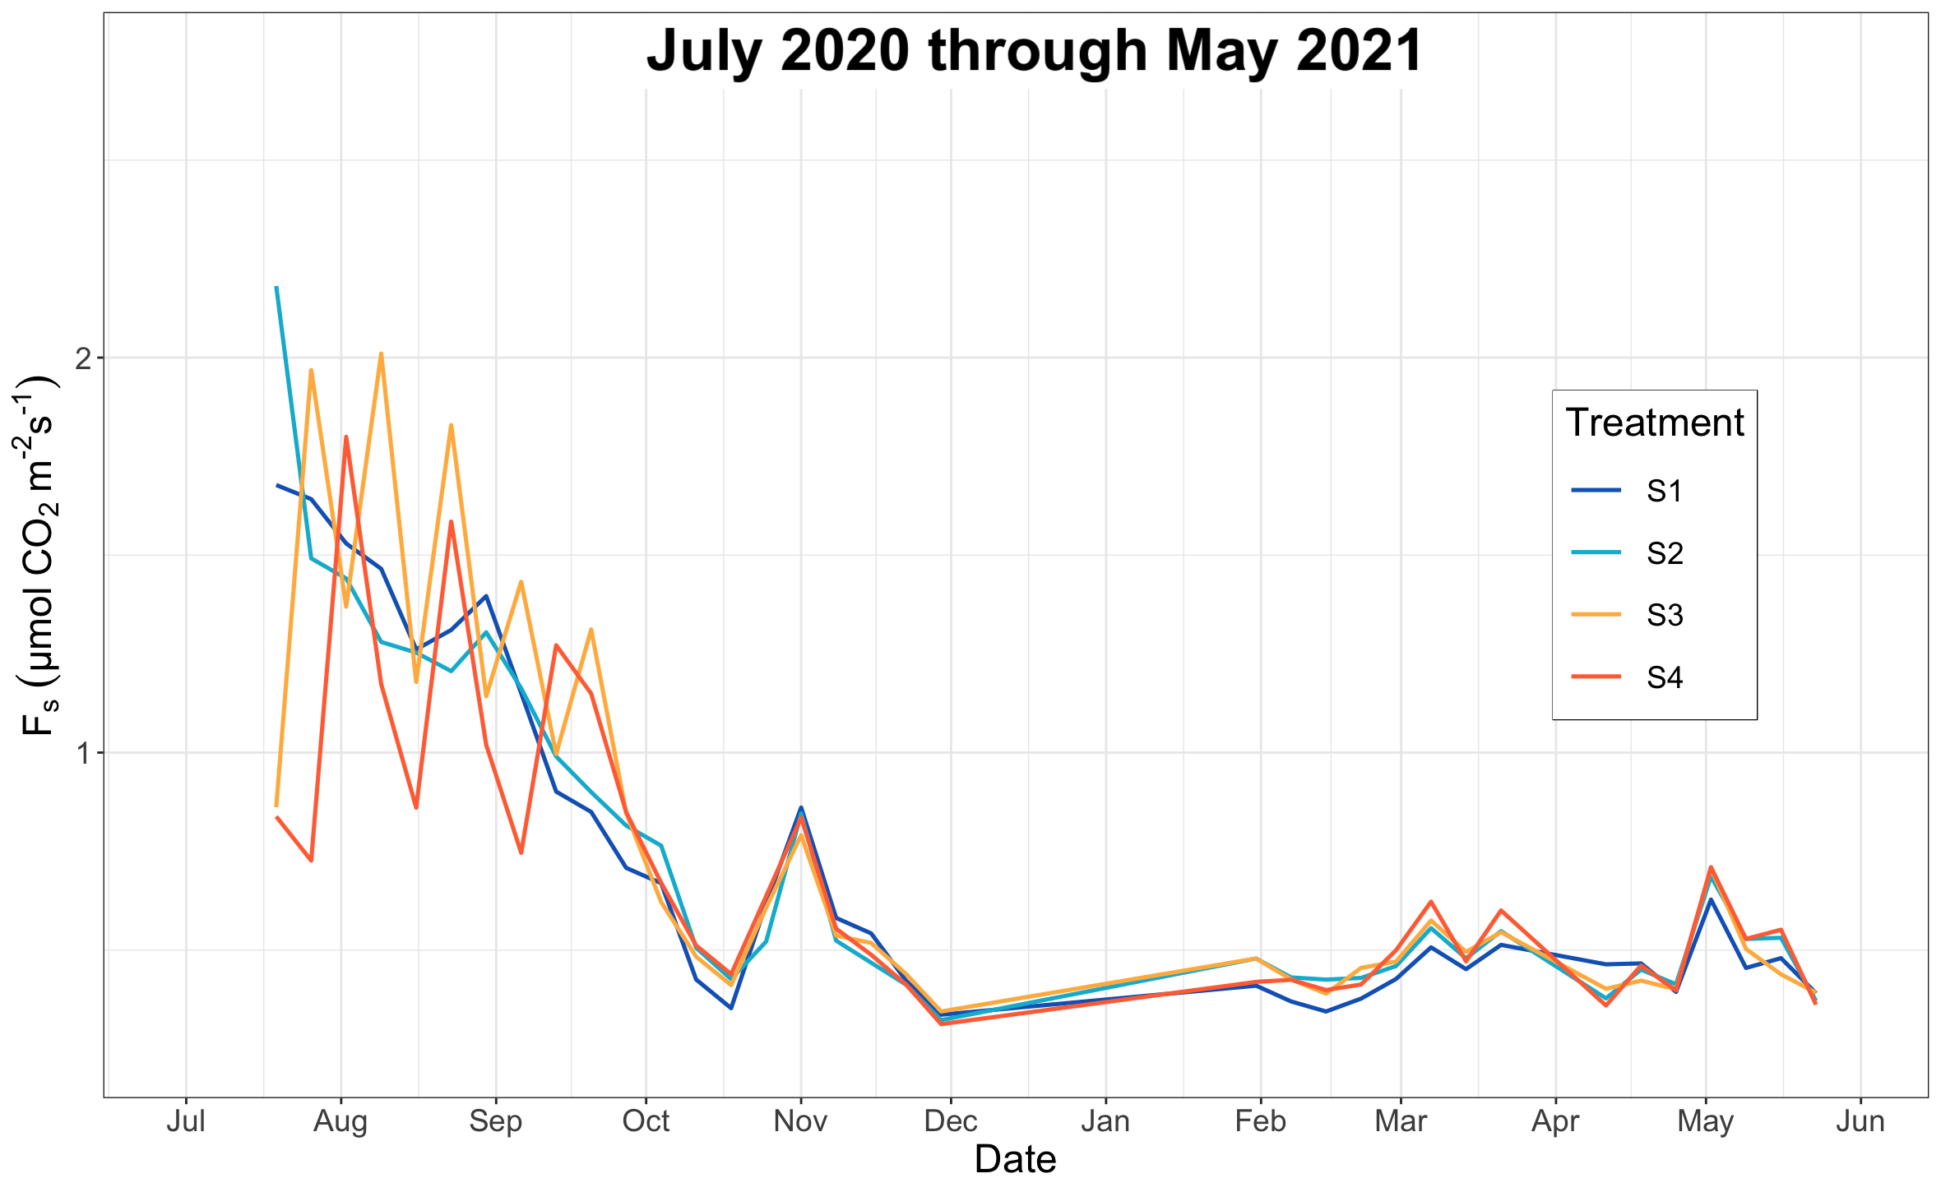
Results
Weekly average soil CO₂ efflux by treatment
F_{s} = Soil CO₂ efflux
S1 = Many, small
S4 = Few, large
Variation among treatments short-lived.
Water inputs and temperature strongly control soil respiration.
Lag effect in plots receiving few, large events.
Gap in data
Extended dry intervals
Low soil CO₂ efflux

Slide 10
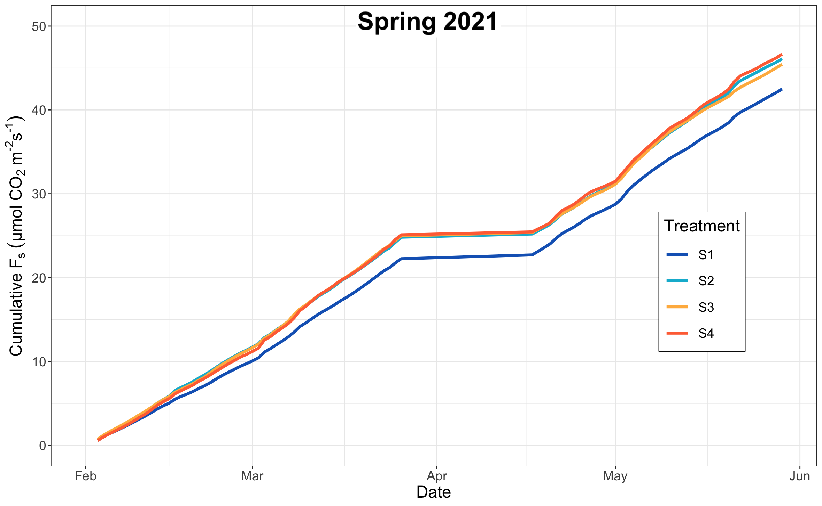
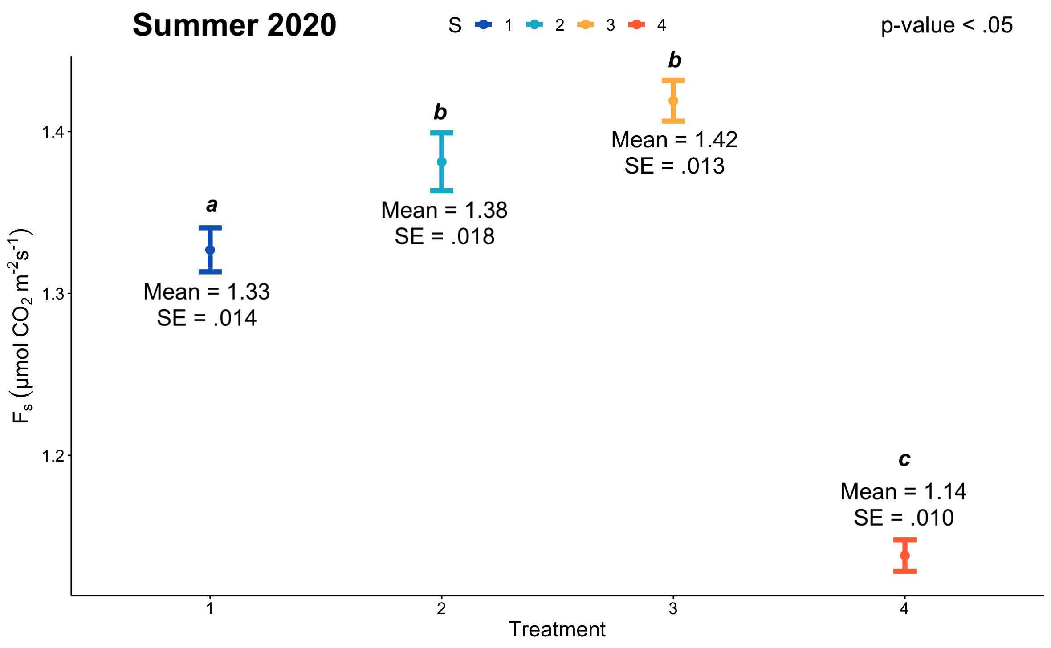
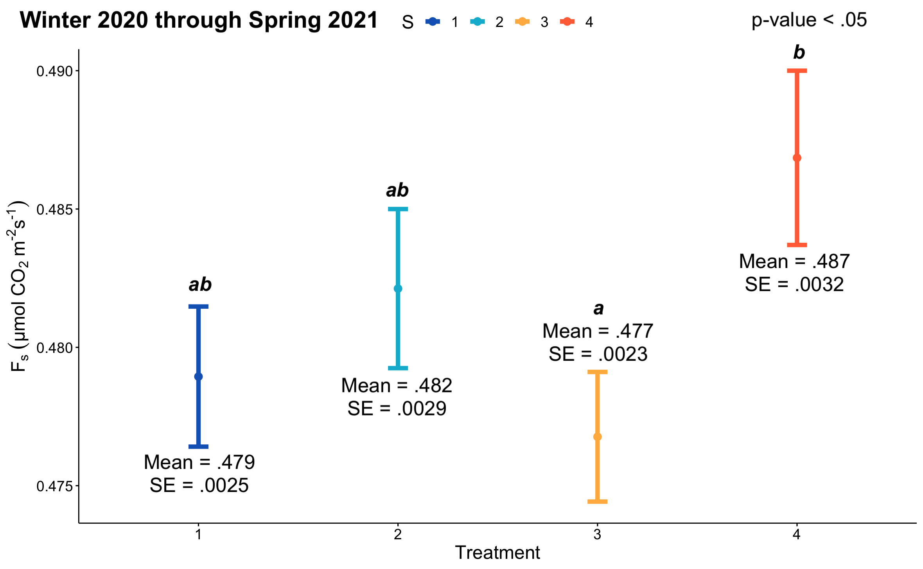
Results
Few, large events produce least total CO₂ efflux during summer.
S4 plots switched to highest efflux the following spring.
Gap in data
Most statistical differences diminish once irrigation is applied equally.
S1 = Many, small
S4 = Few, large
F_{s} = Soil CO₂ efflux
10

Slide 11
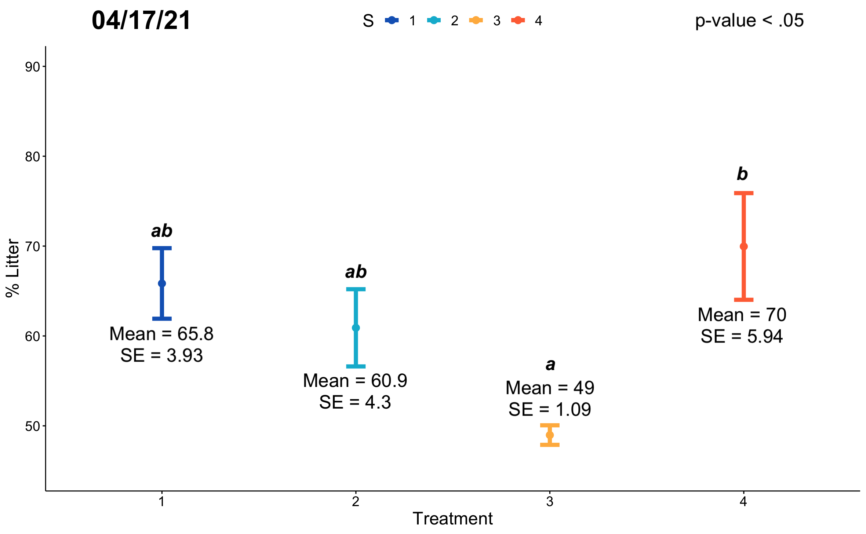
Conclusions
Few, large rain events led to lower cumulative soil respiration in the warm season, which is caused by low efflux during the extended dry periods.
After summer repackaging ended, plots that had received few, large rain events emitted more CO₂.
We find a counteracting legacy effect of warm-season precipitation temporal repackaging on cool-season carbon budgets.
% Litter cover by treatment
S1 = Many, small
S4 = Few, large
Litter: Dead plant material on soil surface.
We hypothesize that slightly greater cool-season litter inputs in the S4 treatment plots, which could lead to more microbial respiration, is linked to this.

Slide 12
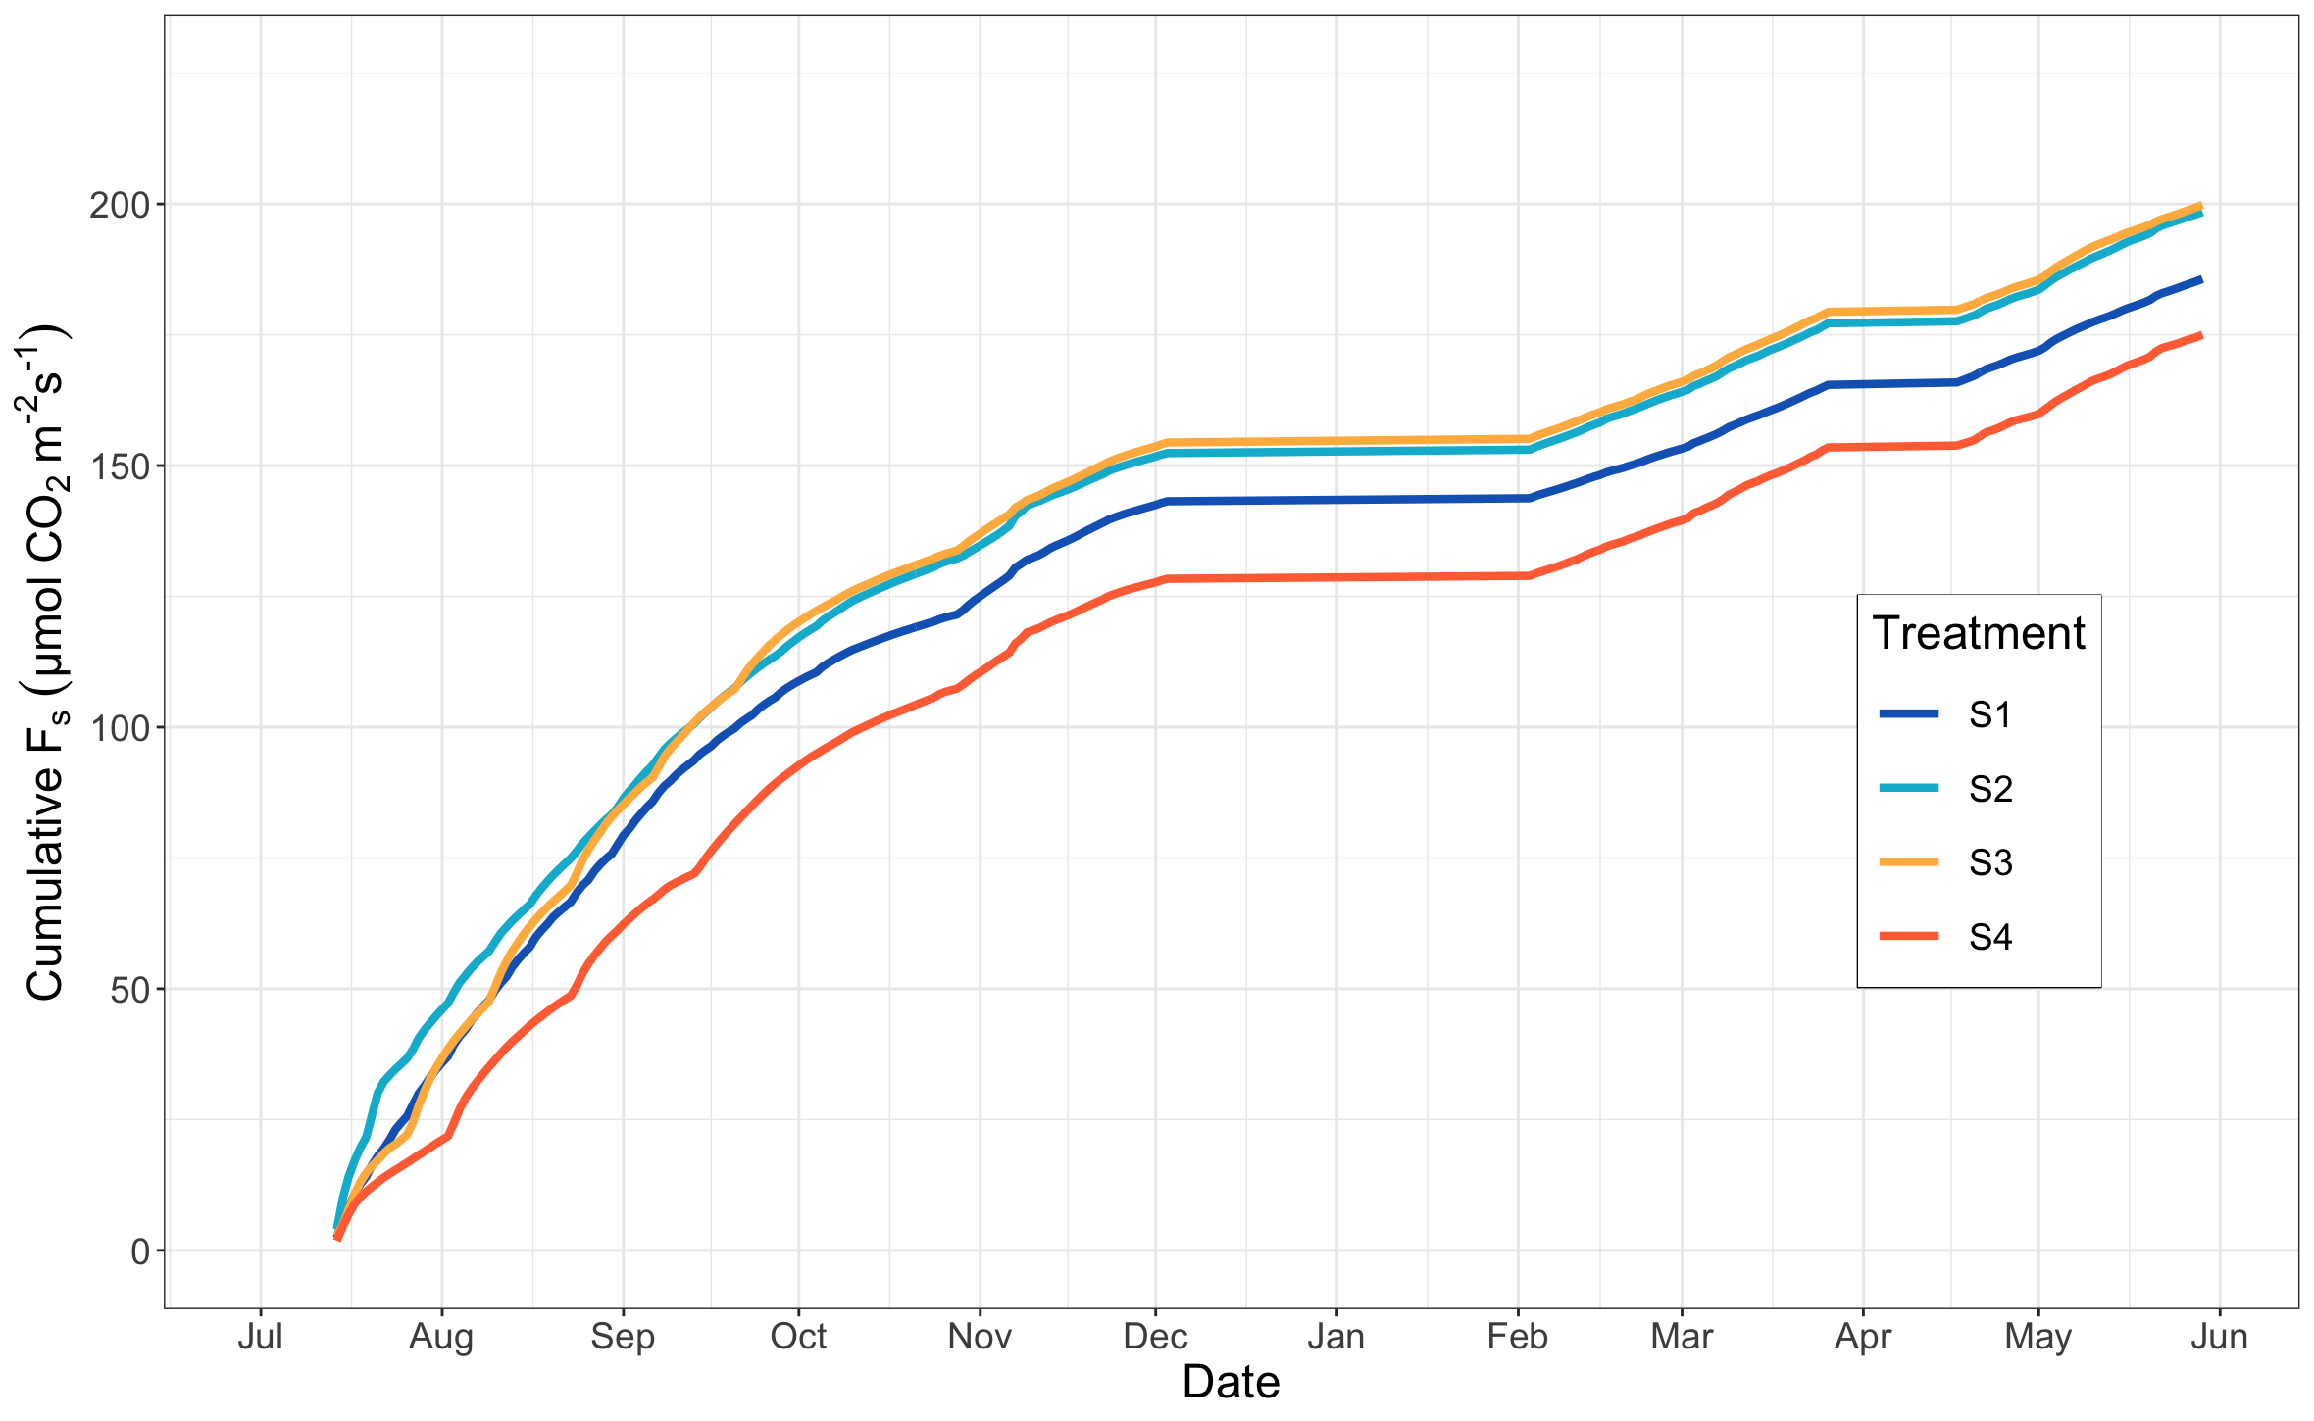
Implications
F_{s} = Soil CO₂ efflux
S1 = Many, small
S4 = Few, large
Evaluating soil respiration rates during the spring growing season is novel because ecological research in the Sonoran Desert most often focuses on the summer growing season.
Gap
Gap
This work reveals that future monsoonal precipitation regimes of larger, less frequent events keeps more carbon in the soil, with only partial compensation by increased CO₂ efflux during the following cool season.

Slide 13
Future Work
Explore cool-season soil respiration over shorter time frames to compare treatment responses to individual irrigation applications.
Investigate how soil moisture and temperature control soil respiration during different periods of the year.
Analyze summer 2021 and subsequent cool-season soil respiration data to assess whether legacies extend to one year or more.

Slide 14
Acknowledgements
I would like to express gratitude to…
My co-authors for their guidance, ideas, and time.
Other RainMan affiliates for making field work a great time.
My family and friends for their love and support.
We acknowledge support for this work provided by a NASA grant awarded to the Arizona/NASA Space Grant Consortium and the United States Department of Agriculture (USDA; cooperative agreement number 58-2022-8-010).

Slide 15
Thank You!

